Slide 1
A Quick Introduction to
Arduino and Sensors
FAF-ONG,Vlad N. Corina S.

Slide 2
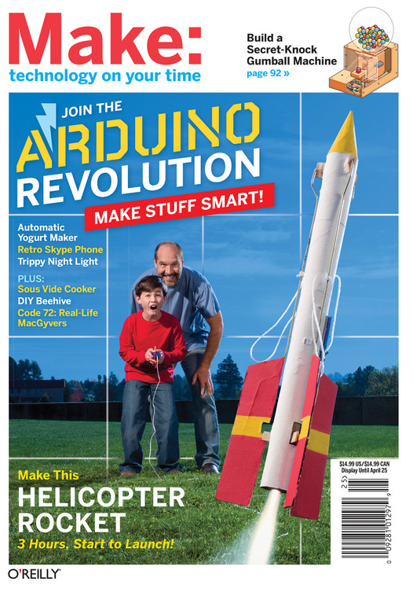

Slide 3
Why Was Arduino Developed?
Physical Computing – using components that can interact with people and with the world around us
The Arduino was originally developed for artists and designers to prototype interactive displays
Developed for non-scientists
Minimalist programming
“Forgiving” circuitry that can handle a wide variety of wiring errors

Slide 4
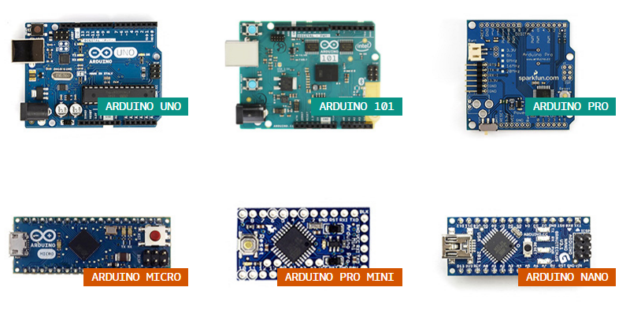
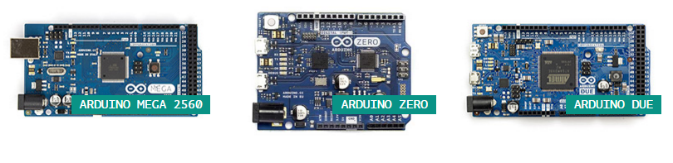
Different Varieties of Arduino

Slide 5

Digital Input / Digital output
(PWM on pins 3, 5, 6, 9, 10, 11)
USB connection
Arduino Uno Revision 3
7-12 volt input power (9v is common)
Power pins
Analog input / Digital input or output

Slide 6
What Can Arduino Uno Be Used To Teach?
Introductory electronics (voltage, current, resistance)
How sensors and actuators work
Rudimentary programming
Design of basic scientific equipment
Troubleshooting
Challenges of communicating with users through a project (e.g., messages, formatting numbers, ease of use, etc.)
Statistics and variation in data gathering

Slide 7
What Can Students Do?
Quickly able to prototype a working project
Able to produce a working computer program
The tactile “feel” of assembling a project is very rewarding; making something that works
FINALLY understanding that a scientific instrument is only as good as its design and calibration
Get to troubleshoot circuits under the tutelage of the instructor to develop a logical, orderly method.

Slide 8
What Approach Have I Followed?
Philosophical Approach
It is physically impossible to teach students a comprehensive course in electronics in a single semester
The purpose of our electronics course is to teach the basics of instrument design, function, and troubleshooting
It is important to teach students the basics of electronics and teach them how to learn electronics on their own

Slide 9
What Approach Have I Followed?
Start simple – build confidence with small projects before trying complex projects
Introduce concept and then immediately do a project with it
Use components that will capture the attention and imagination of the students
Use new projects to build on previous projects
Create a “problem” for students to solve that THEY will see as practical but not overly complicated
Teach students how to search for needed information from datasheets (e.g., tolerances, current limits, etc.) from the internet

Slide 10
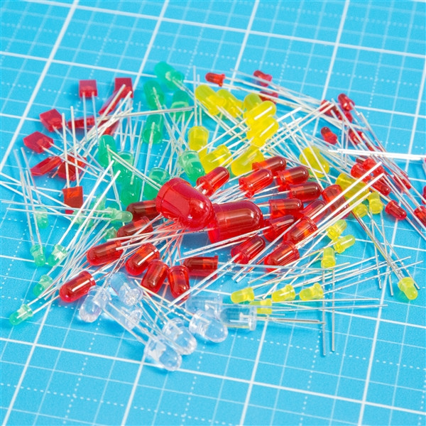
What Are Some Good Components to Start With?
LEDs….lots of LEDs with variety of colors (be sure to also acquire lots of current-limiting resistors)
Good for blinking, dimming using PWM, “Knight Rider” effect with 8 or more LEDs, strobe effects, etc.

Slide 11
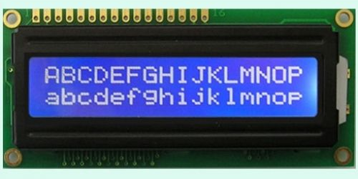
What Are Some Good Components to Start With?
LCD Screen with backlight (16x2 is common and teaches the complications of textual display)
The parallel version uses 4 digital pins for display
Instructions for how to connect is built in as a sample “sketch” in the Arduino
Students get a huge degree of satisfaction from transmitting text to the LCD screen

Slide 12
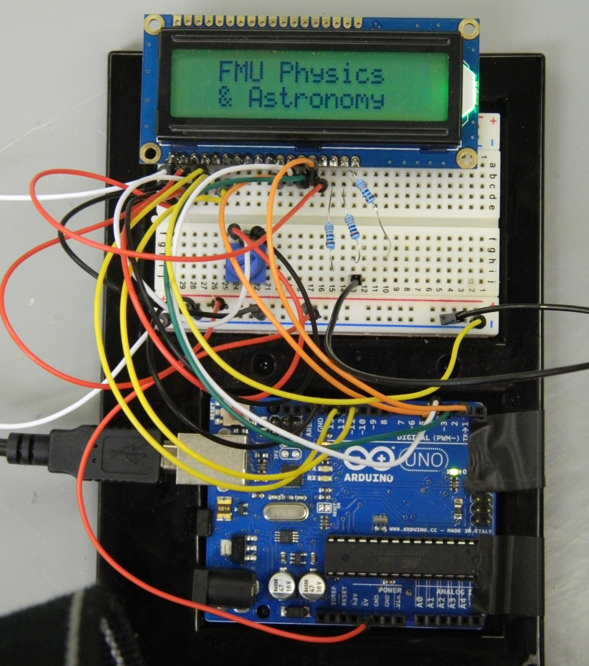
Current-limiting resistors for RGB backlight
10 kΩ potentiometer to adjust screen contrast

Slide 13
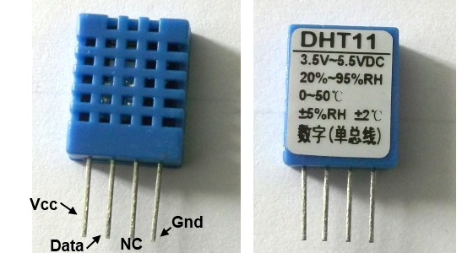
What Are Some Good Components to Start With?
Basic temperature and/or humidity sensor
DHT11 or DHT22 is a good entry-level choice
Library can be downloaded and incorporated to give easy access to features of the sensor

Slide 14
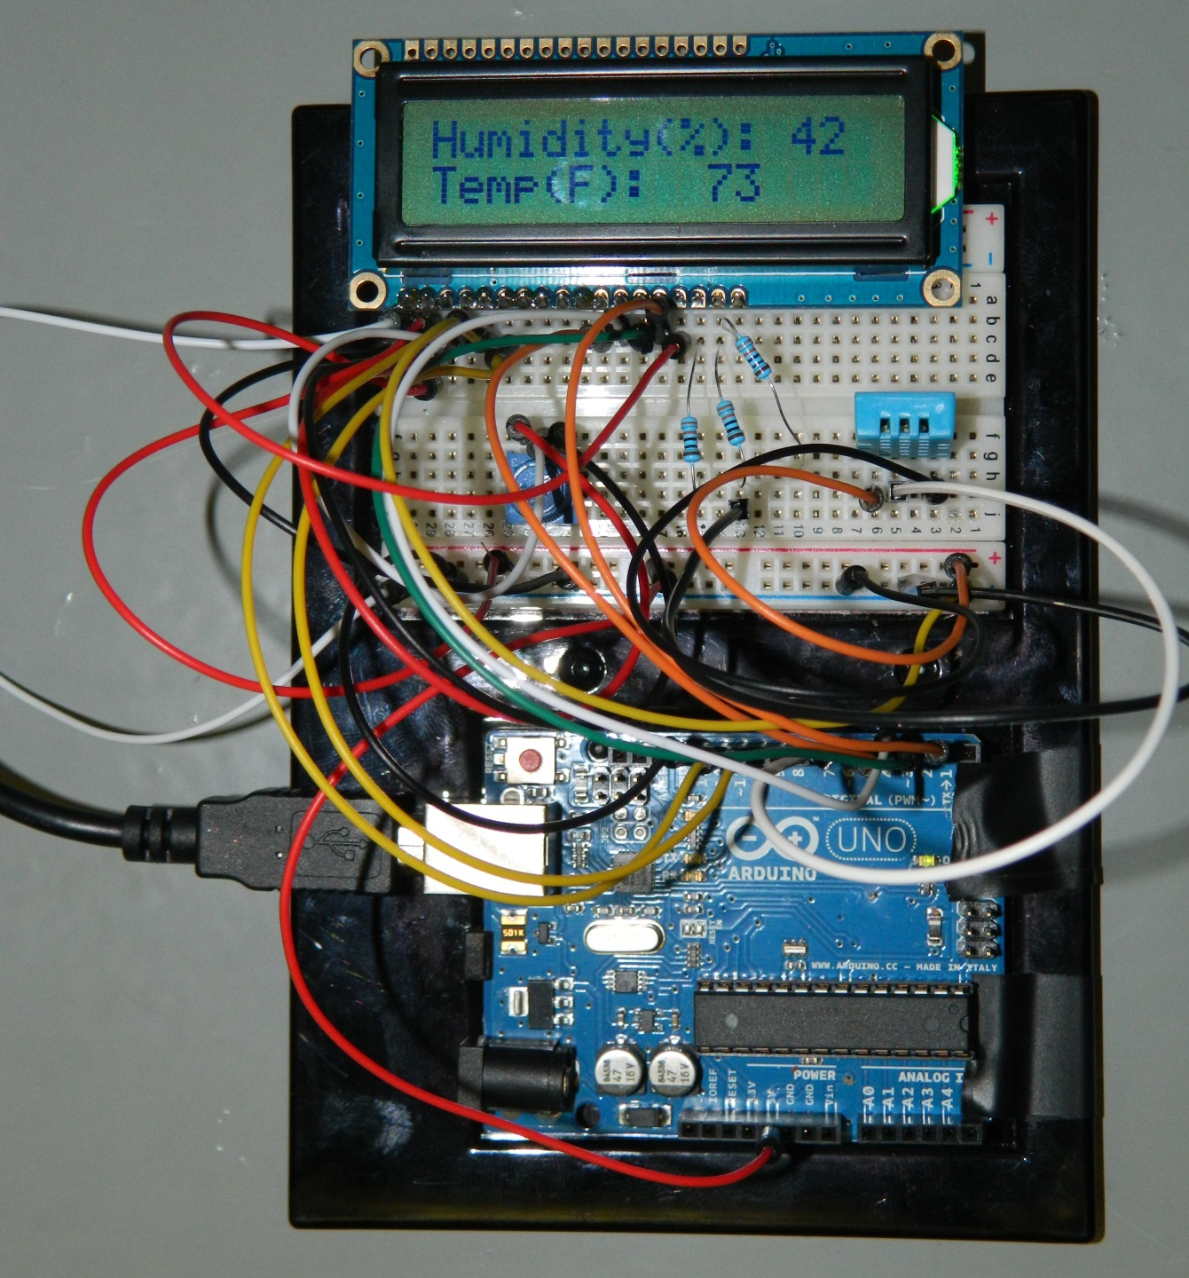
Current-limiting resistors for RGB backlight
DHT 11 Sensor

Slide 15
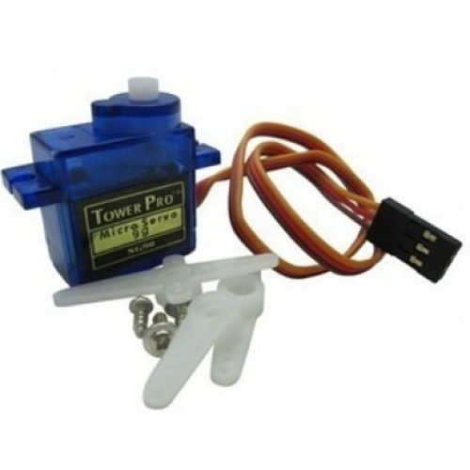
What Are Some Good Components to Start With?
Small servos
Arduino can be used to position servo at a given angle for use in projects.
Other sensors can be attached to the servo to add a layer of complexity
Servo library included in Arduino IDE

Slide 16
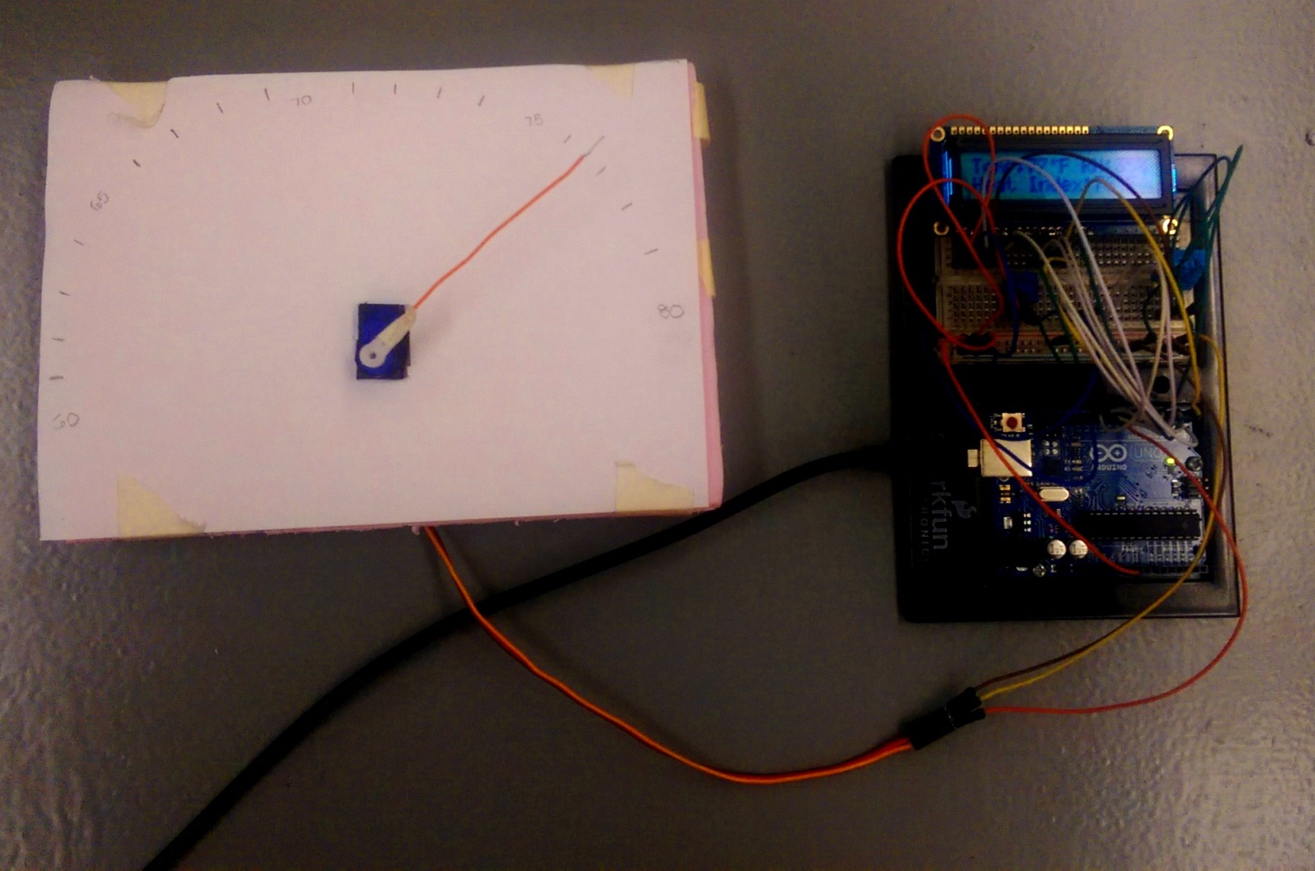

Slide 17
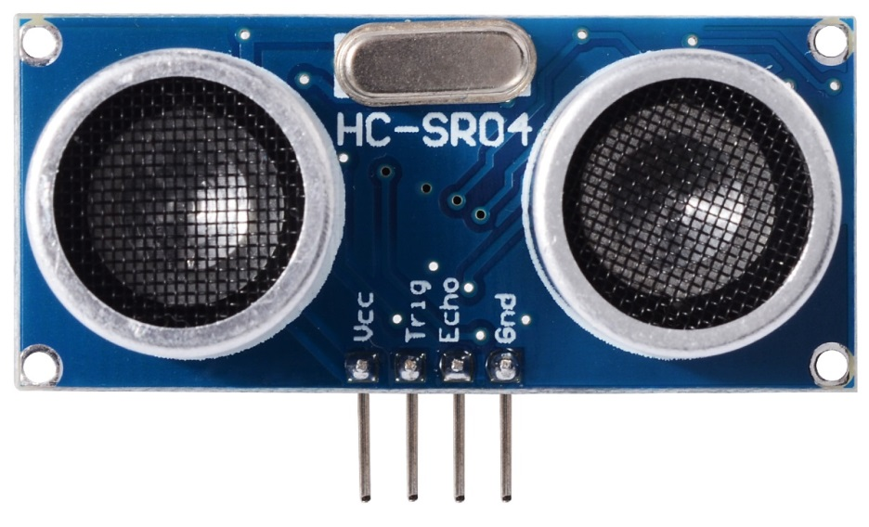
What Are Some Good Components to Start With?
Ultrasonic Ranger – uses ultrasonic waves to determine the distance between sensor and object based on time between emission of wave and echo of it.
Good for introducing discussion of speed of sound variation with environmental conditions
Calibration principles are easily discussed

Slide 18
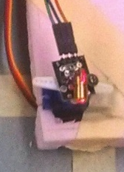

Laser pointer mounted on servo that aims at a target based on readings of dual sonic rangers
Sonic Rangers

Slide 19
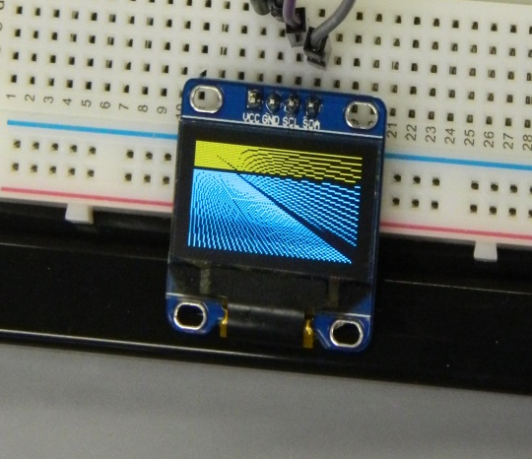
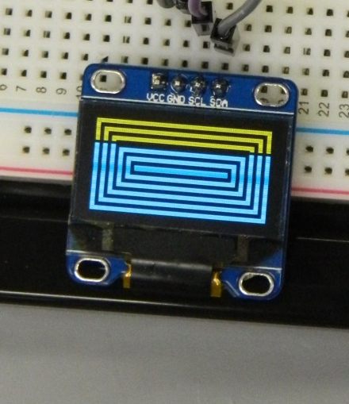
What Are Some Other Components That Are Relatively Easy to Use?
128x64 Organic LED screen that can handle graphics as well as text

Slide 20
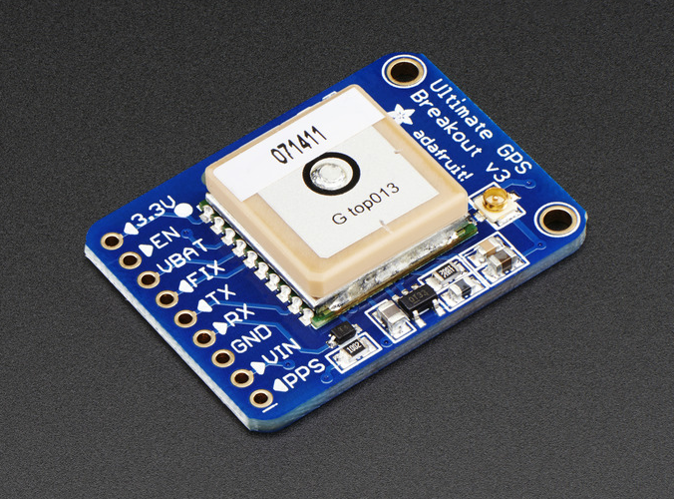
What Are Some Other Components That Are Relatively Easy to Use?
GPS Module that can be used for a variety of purposes such as triggering a response only when the user is standing in a particular location

Slide 21
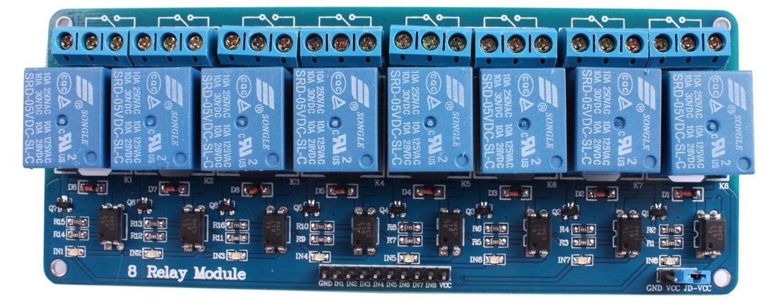
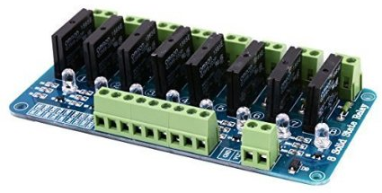
What Are Some Other Components That Are Relatively Easy to Use?
Mechanical or Solid-State Relay Boards to control alternating current loads of several amps

Slide 22
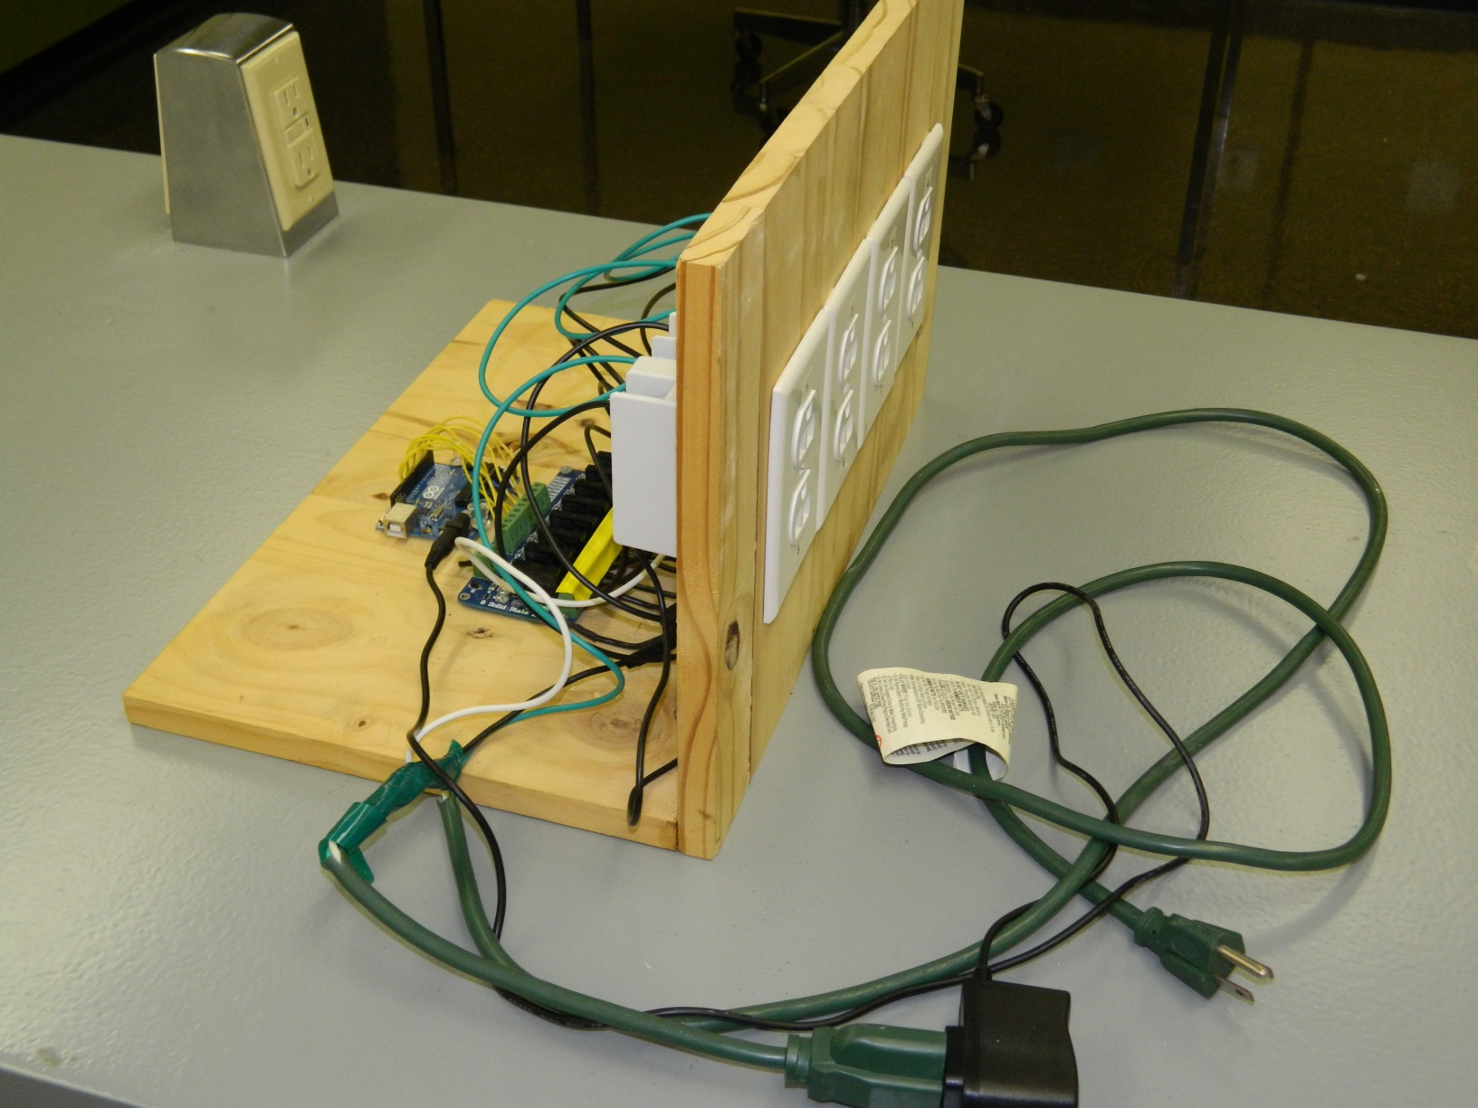
AC Outlets Controlled by Arduino

Slide 23
Resources
www.arduino.cc :info on hardware, some libraries for sensors, the integrated development environment (IDE) and reference material on commands and structures
www.instructables.com : info on DIY projects prepared by others
www.makezine.com : Home of Make Magazine, which has lots of Arduino projects

Slide 24
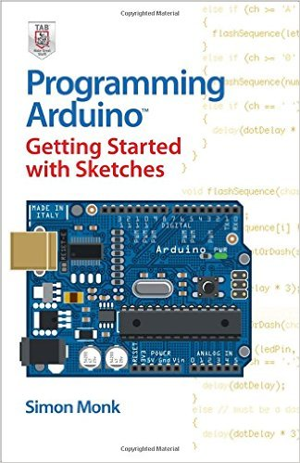
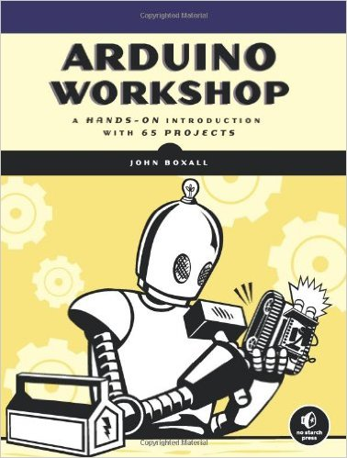
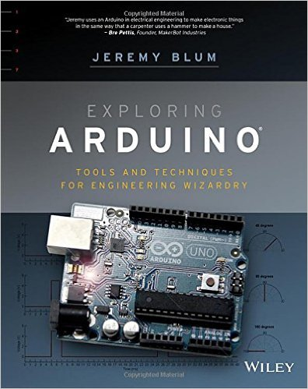
Recommended Books
By
Simon Monk
By
John Boxall
By
Jeremy Blum

